Slide 1
Gesture Based UI
James Ngondo
Hary Wang
Julien Yaho

Slide 2
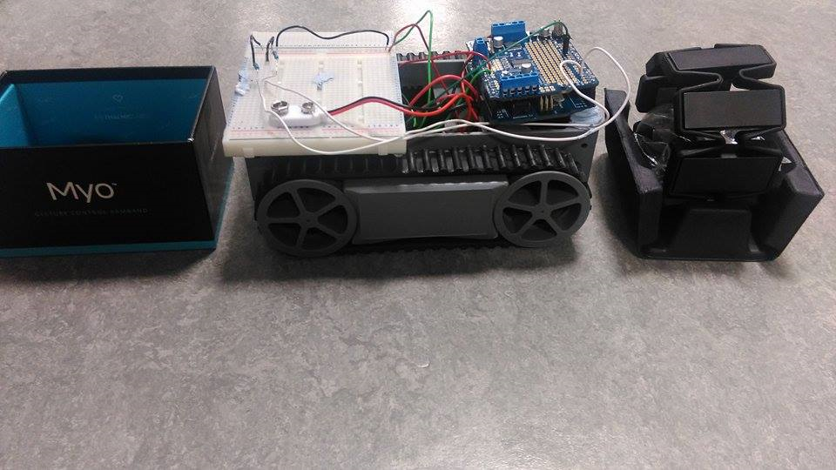
What the project is about

Slide 3
Purpose of the project
Interact with robots
Learn to assemble electronic components
Programming in C

Slide 4
Frustrations
Incompatible hardware resources – Adafruit Motorshield / Ultra-sonic sensors
Damaged Arduino
Soldering of components

Slide 5
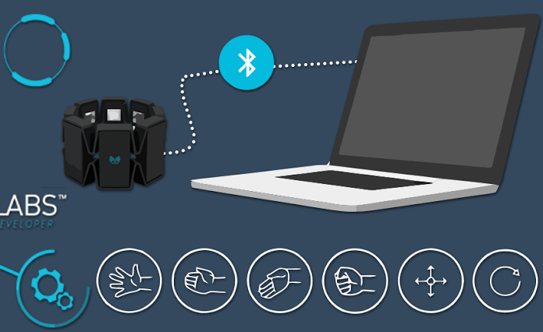
Gestures Identified
Wave Out
Wave In
Fist
Fingers Spread

Slide 6
Hardware & Software Used
Robot truck with two DC Motors
A Myo Armband
An Arduino board
Adafruit Motorshield
The Arduino software/IDE
A bunch of LEDs.
A bread board
4v battries
2.2k ohm Resistor
Microsoft Visual C++ Runtime

Slide 7
Switch(){
Wave-In → motors[Backward / Forward]
Wave-Out → motors[Forward / Backward]
Fist → motors[ Release / Release → LED stop]
Fingers Spread → motors[Forward / Forward]
}

Slide 8
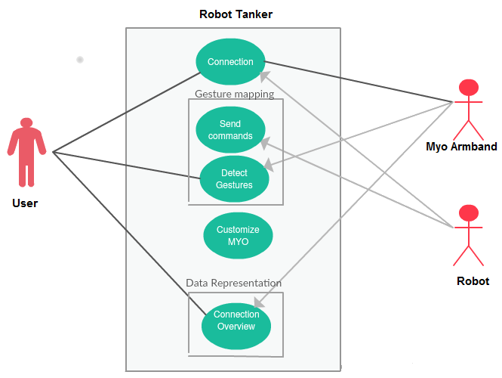
Architecture

Slide 9

Video Demo

Slide 10
Conclusion
Minimize our dependence on huge hardware and software systems that control robots and other devices
Military
Hospitals

Slide 11
Recommendations
Implementing ultrasonic sensors
Temperature sensors & databases
Speech recognition implementation

